Slide 1
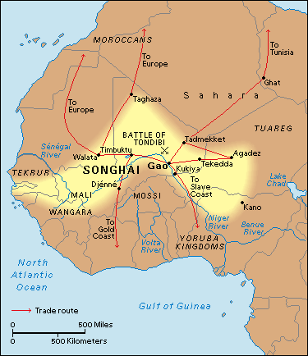
Trade Routes & Geography of Songhai
Songhay was located West of the Saharan Desert. It had the Niger River hitting the sides of the south of its territory. The desert protected them from enemy intruders. The Niger River gave easy travel for traders, and great defense against enemies.
Songhay used slaves to transport goods across the Saharan Desert towards Morocco and the middle East. The slaves they used were usually captives from war. Songhay traded kola nuts, leather, dates, salt, gold, and ivory.

